Slide 1
KTH New International Student Arrival Page
Group 2
Thays Sruti Bosen

Slide 2
Table of Content
0
1
2
3
Planning
Field Study on KTH Official Website
Design of International Student Arrival System
Evaluation on the Improved System

Slide 3


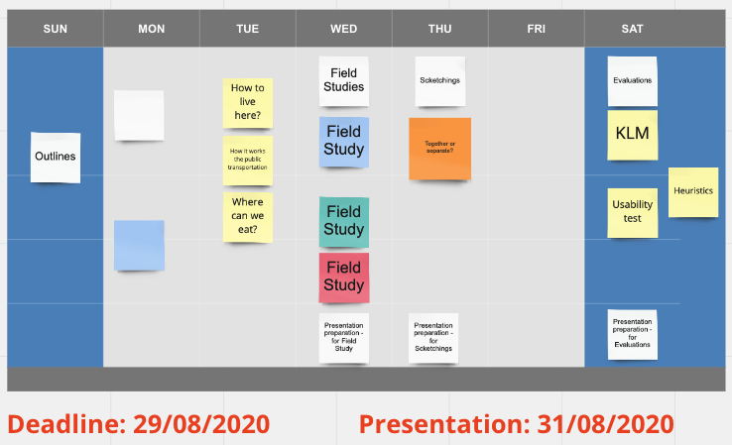
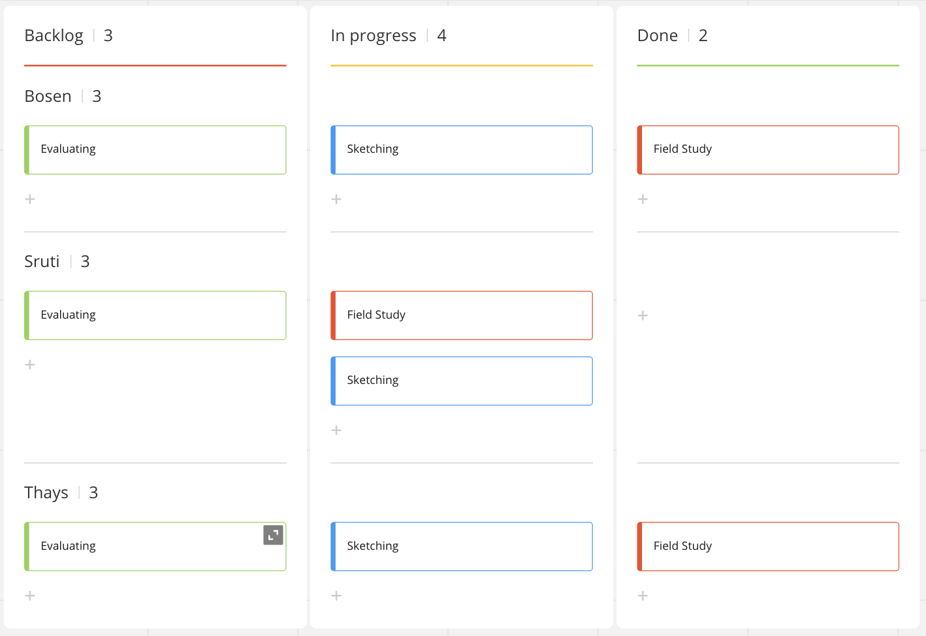
Planning
Notes:
The name of interviewees are hidden by the blue box

Slide 4
Field Study

Slide 5
Field Study on KTH Official Website
Interview Plan
Questions:
Do you use the KTH official website to find information?
Where do you find information about accommodation, eating, transportation?
Did you try to find any information about living in Sweden on KTH website? Did you find it there? Is it useful?
Locations: KTH Campus, Lappis
Interviewees: New international students from different region

Slide 6
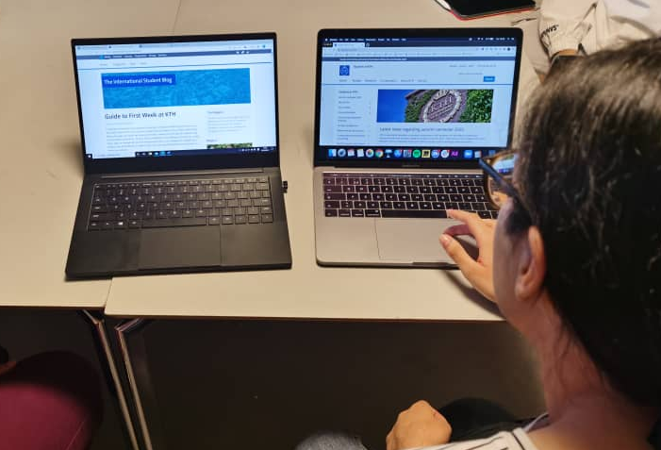
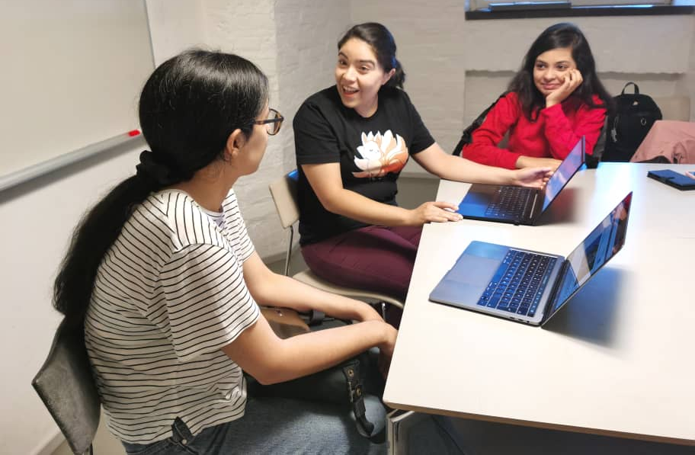
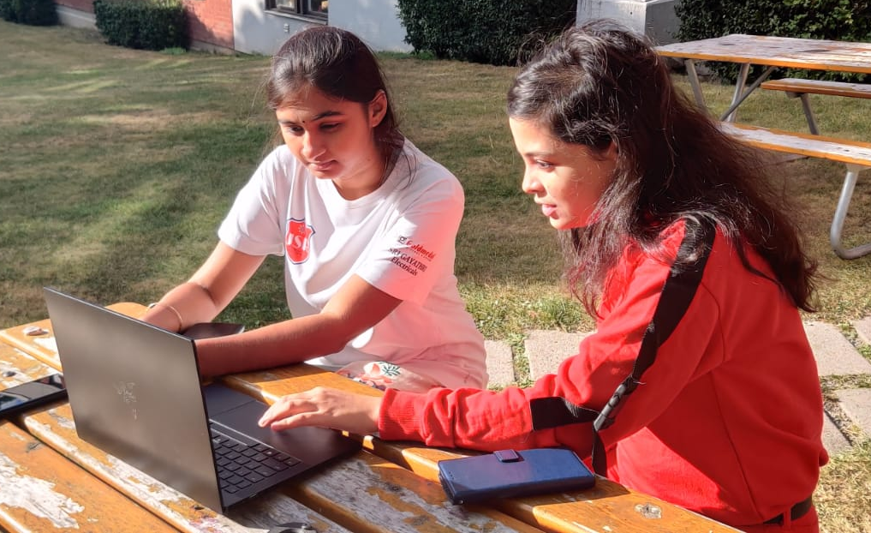
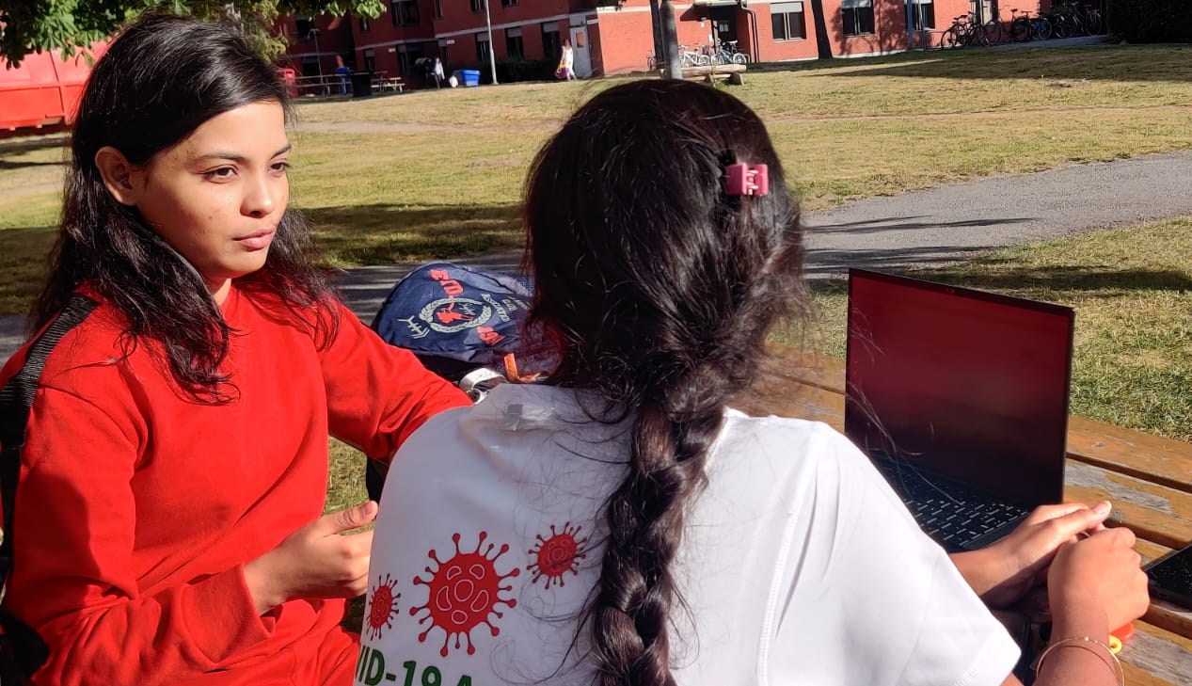
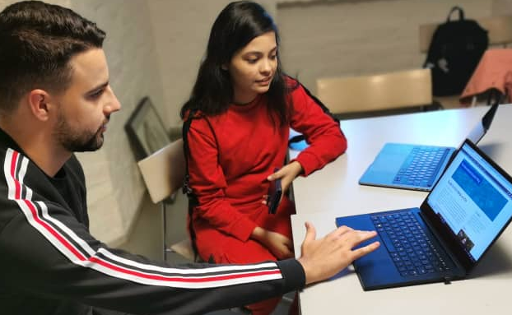
Field Study on KTH Official Website
Procedure

Slide 7
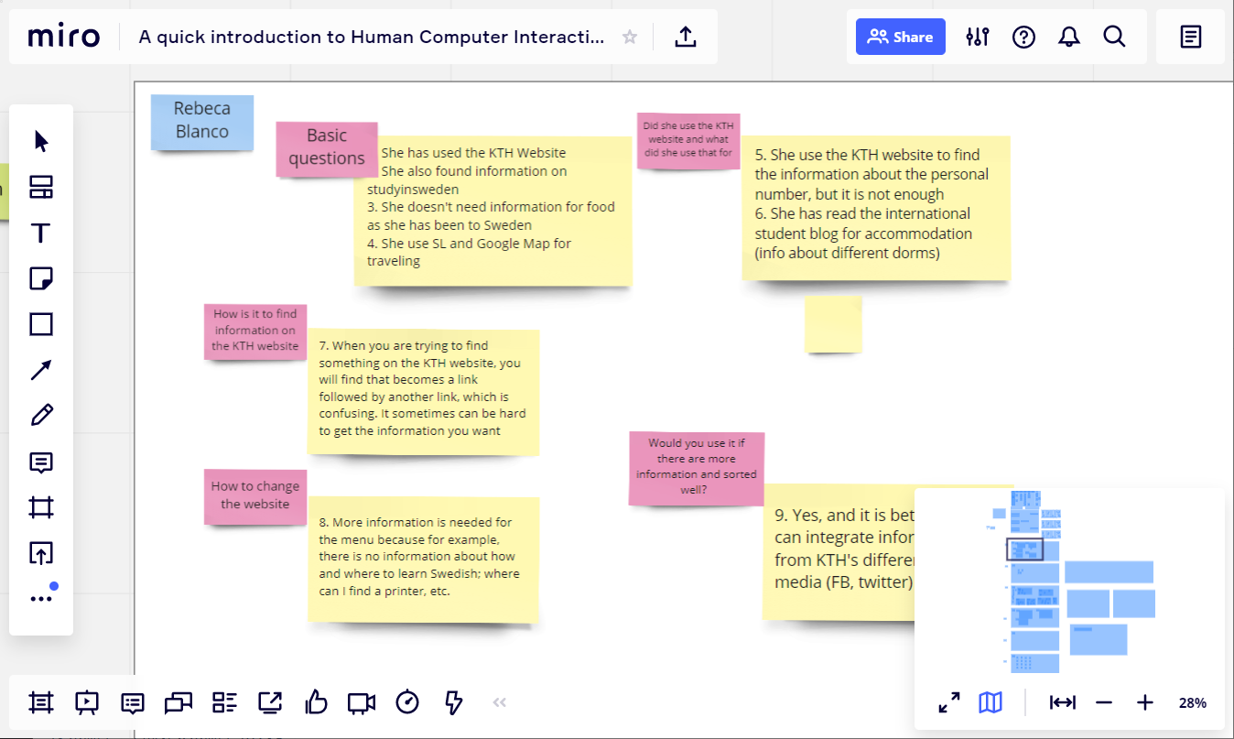
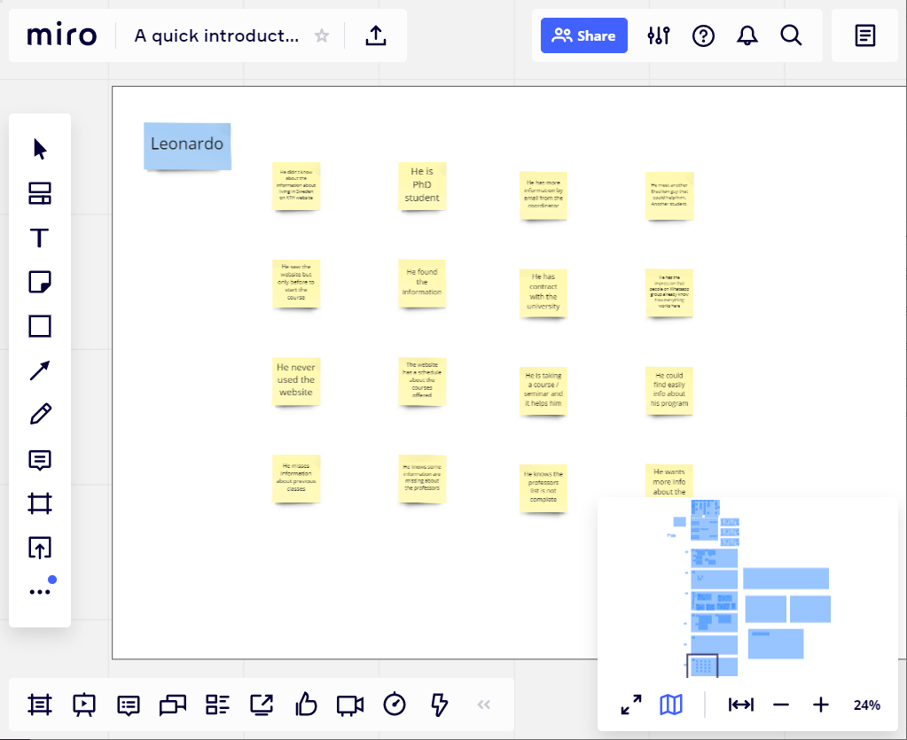
Field Study on KTH Official Website
Procedure
Notes:
The name of interviewees are hidden by the blue box

Slide 8
Field Study on KTH Official Website
Conclusion
Missing some information, student still need to google
Confusing when navigation on the website (links after links)
Flow chart for new student
Flow chart about Course (where to get course information, how to use Canvas, class location)
Notes:
Temp conclusion.

Slide 9
Design

Slide 10
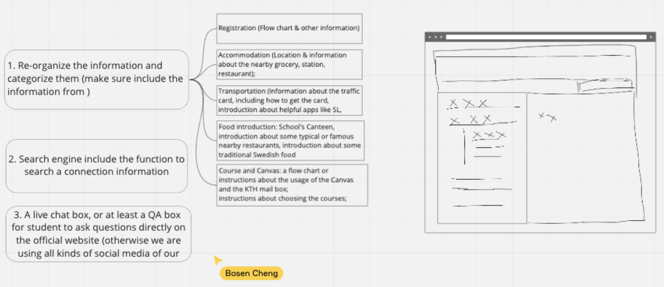
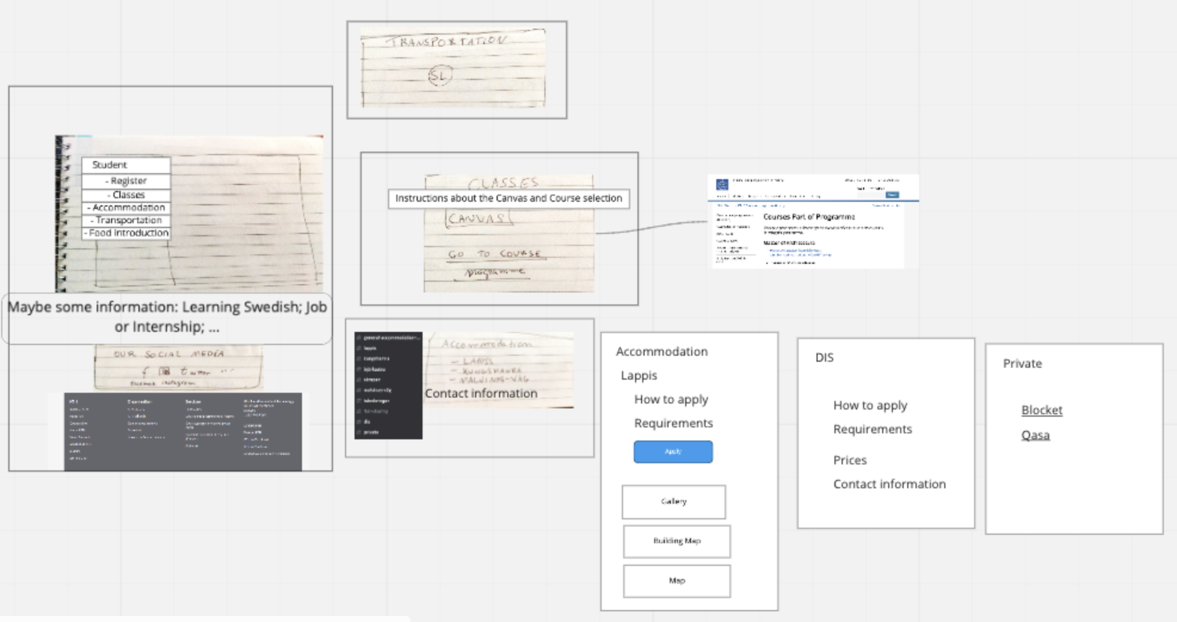
Design of International Student Arrival System
Prototype ideas
Prototype: https://www.figma.com/proto/mraSY5piUB8iksUG6jqJwn/Intro-HCI?node-id=17%3A38&scaling=min-zoom

Slide 11
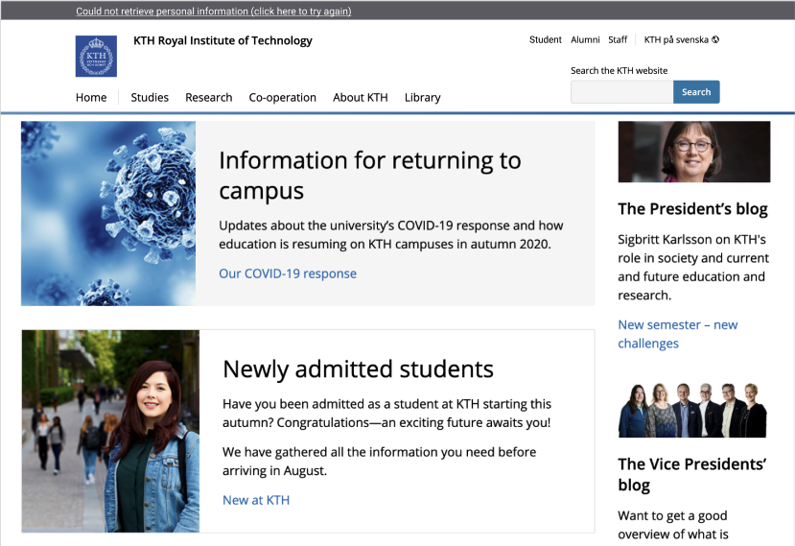

Design of International Student Arrival System
Changes - Home
Text in English
Links pointing to the same page
Prototype: https://www.figma.com/proto/mraSY5piUB8iksUG6jqJwn/Intro-HCI?node-id=17%3A38&scaling=min-zoom

Slide 12
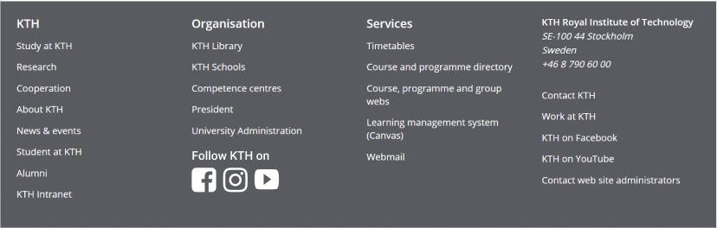
Design of International Student Arrival System
Changes - Home
KTH Social Media

Slide 13
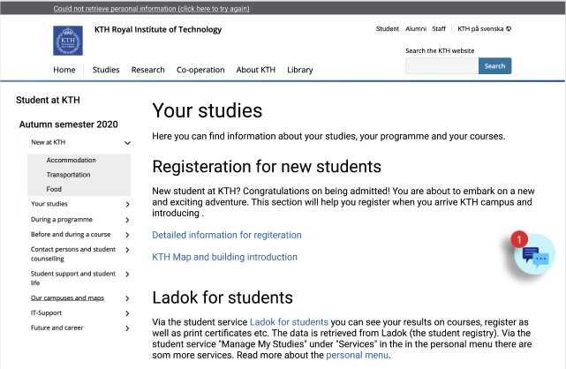
Design of International Student Arrival System
Changes - Student Page
New Side Menu
Chat
New Content

Slide 14
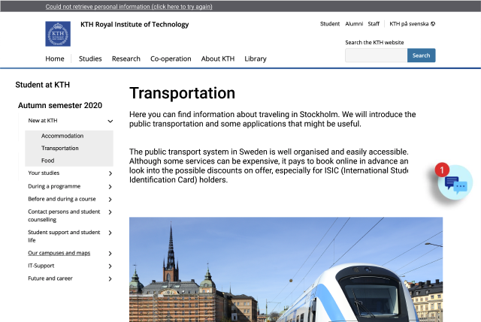
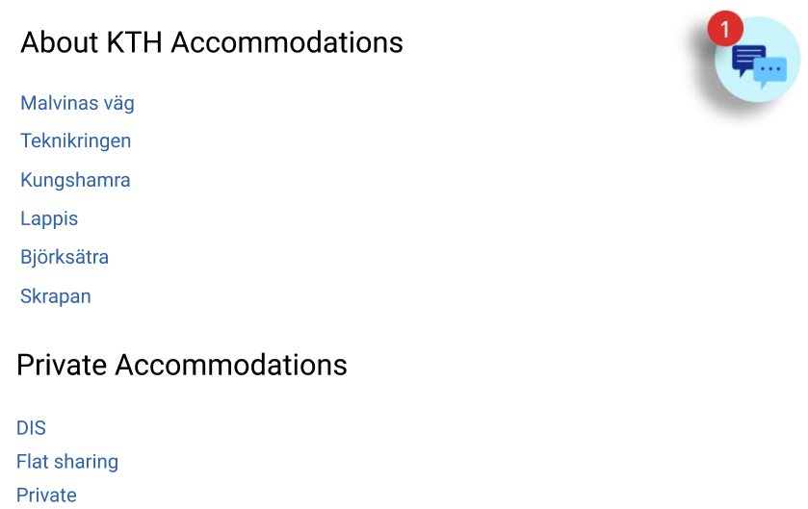
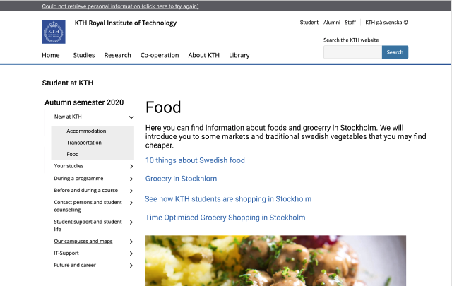
Design of International Student Arrival System
Changes - Other pages

Slide 15
Design of International Student Arrival System
Changes - Final Prototype
Click on the image to go to the prototype

Slide 16
Evaluation

Slide 17
Evaluation on the Improved System
Nielsens Heuristics Evaluation
Visibility of system status
Match between system and the real world
User control and freedom
Consistency and standards
Error prevention
Yes
Yes
Yes
No
It depends
Notes:
#1: Visibility of system status
The system should always keep users informed about what is going on, through appropriate feedback within reasonable time.
#2: Match between system and the real world
The system should speak the users' language, with words, phrases and concepts familiar to the user, rather than system-oriented terms. Follow real-world conventions, making information appear in a natural and logical order.
#3: User control and freedom
Users often choose system functions by mistake and will need a clearly marked "emergency exit" to leave the unwanted state without having to go through an extended dialogue. Support undo and redo.
#4: Consistency and standards
Users should not have to wonder whether different words, situations, or actions mean the same thing. Follow platform conventions.
#5: Error prevention
Even better than good error messages is a careful design which prevents a problem from occurring in the first place. Either eliminate error-prone conditions or check for them and present users with a confirmation option before they commit to the action.

Slide 18
Evaluation on the Improved System
Nielsens Heuristics Evaluation
Recognition rather than recall
Flexibility and efficiency of use
Aesthetic and minimalist design
Help users recognize, diagnose, and recover from errors
Help and documentation
Yes
—
Yes
—
Yes
Notes:
#6: Recognition rather than recall
Minimize the user's memory load by making objects, actions, and options visible. The user should not have to remember information from one part of the dialogue to another. Instructions for use of the system should be visible or easily retrievable whenever appropriate.
#7: Flexibility and efficiency of use
Accelerators — unseen by the novice user — may often speed up the interaction for the expert user such that the system can cater to both inexperienced and experienced users. Allow users to tailor frequent actions.
#8: Aesthetic and minimalist design
Dialogues should not contain information which is irrelevant or rarely needed. Every extra unit of information in a dialogue competes with the relevant units of information and diminishes their relative visibility.
#9: Help users recognize, diagnose, and recover from errors
Error messages should be expressed in plain language (no codes), precisely indicate the problem, and constructively suggest a solution.
#10: Help and documentation
Even though it is better if the system can be used without documentation, it may be necessary to provide help and documentation. Any such information should be easy to search, focused on the user's task, list concrete steps to be carried out, and not be too large.

Slide 19
Evaluation on the Improved System
Survey Tasks and Questions
Questions:
As the first task, I want to ask you to find information about the accommodation Malvinas Väg? How would you do that?
Please, find information about what metro can we use in Stockholm.
Can you try to find KTH Social media?
Can you find instructions about groceries in Stockholm?
Did you find the tasks hard or easy and do you have suggestions about how we could improve it?
Locations: Online zoom meeting
Interviewees: New international students from different region

Slide 20
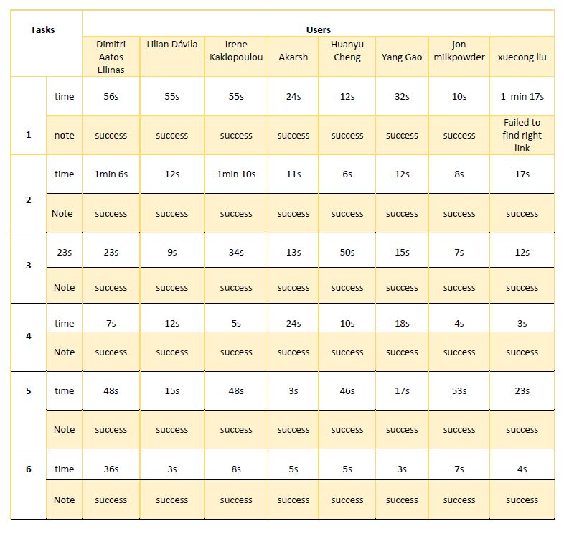
Evaluation on the Improved System
Results

Slide 21
Evaluation on the Improved System
Results
The general comment for those tasks is easy or at least not hard
Some are requiring for more information:
“Maybe you can add information about normal lives in Sweden, such as personal identity number, Bank Card, phone number, etc.”
“She wanted more info about accommodation with pictures. Also the difference between Ladok and Canvas. And a timeline with that should be done before start the classes”
“He missed a link to the Student Union”
Navigation problem: 3 out of 6 students said that some links on the KTH menu are still complex

Slide 22
Thank you
Q & A

